Slide 1
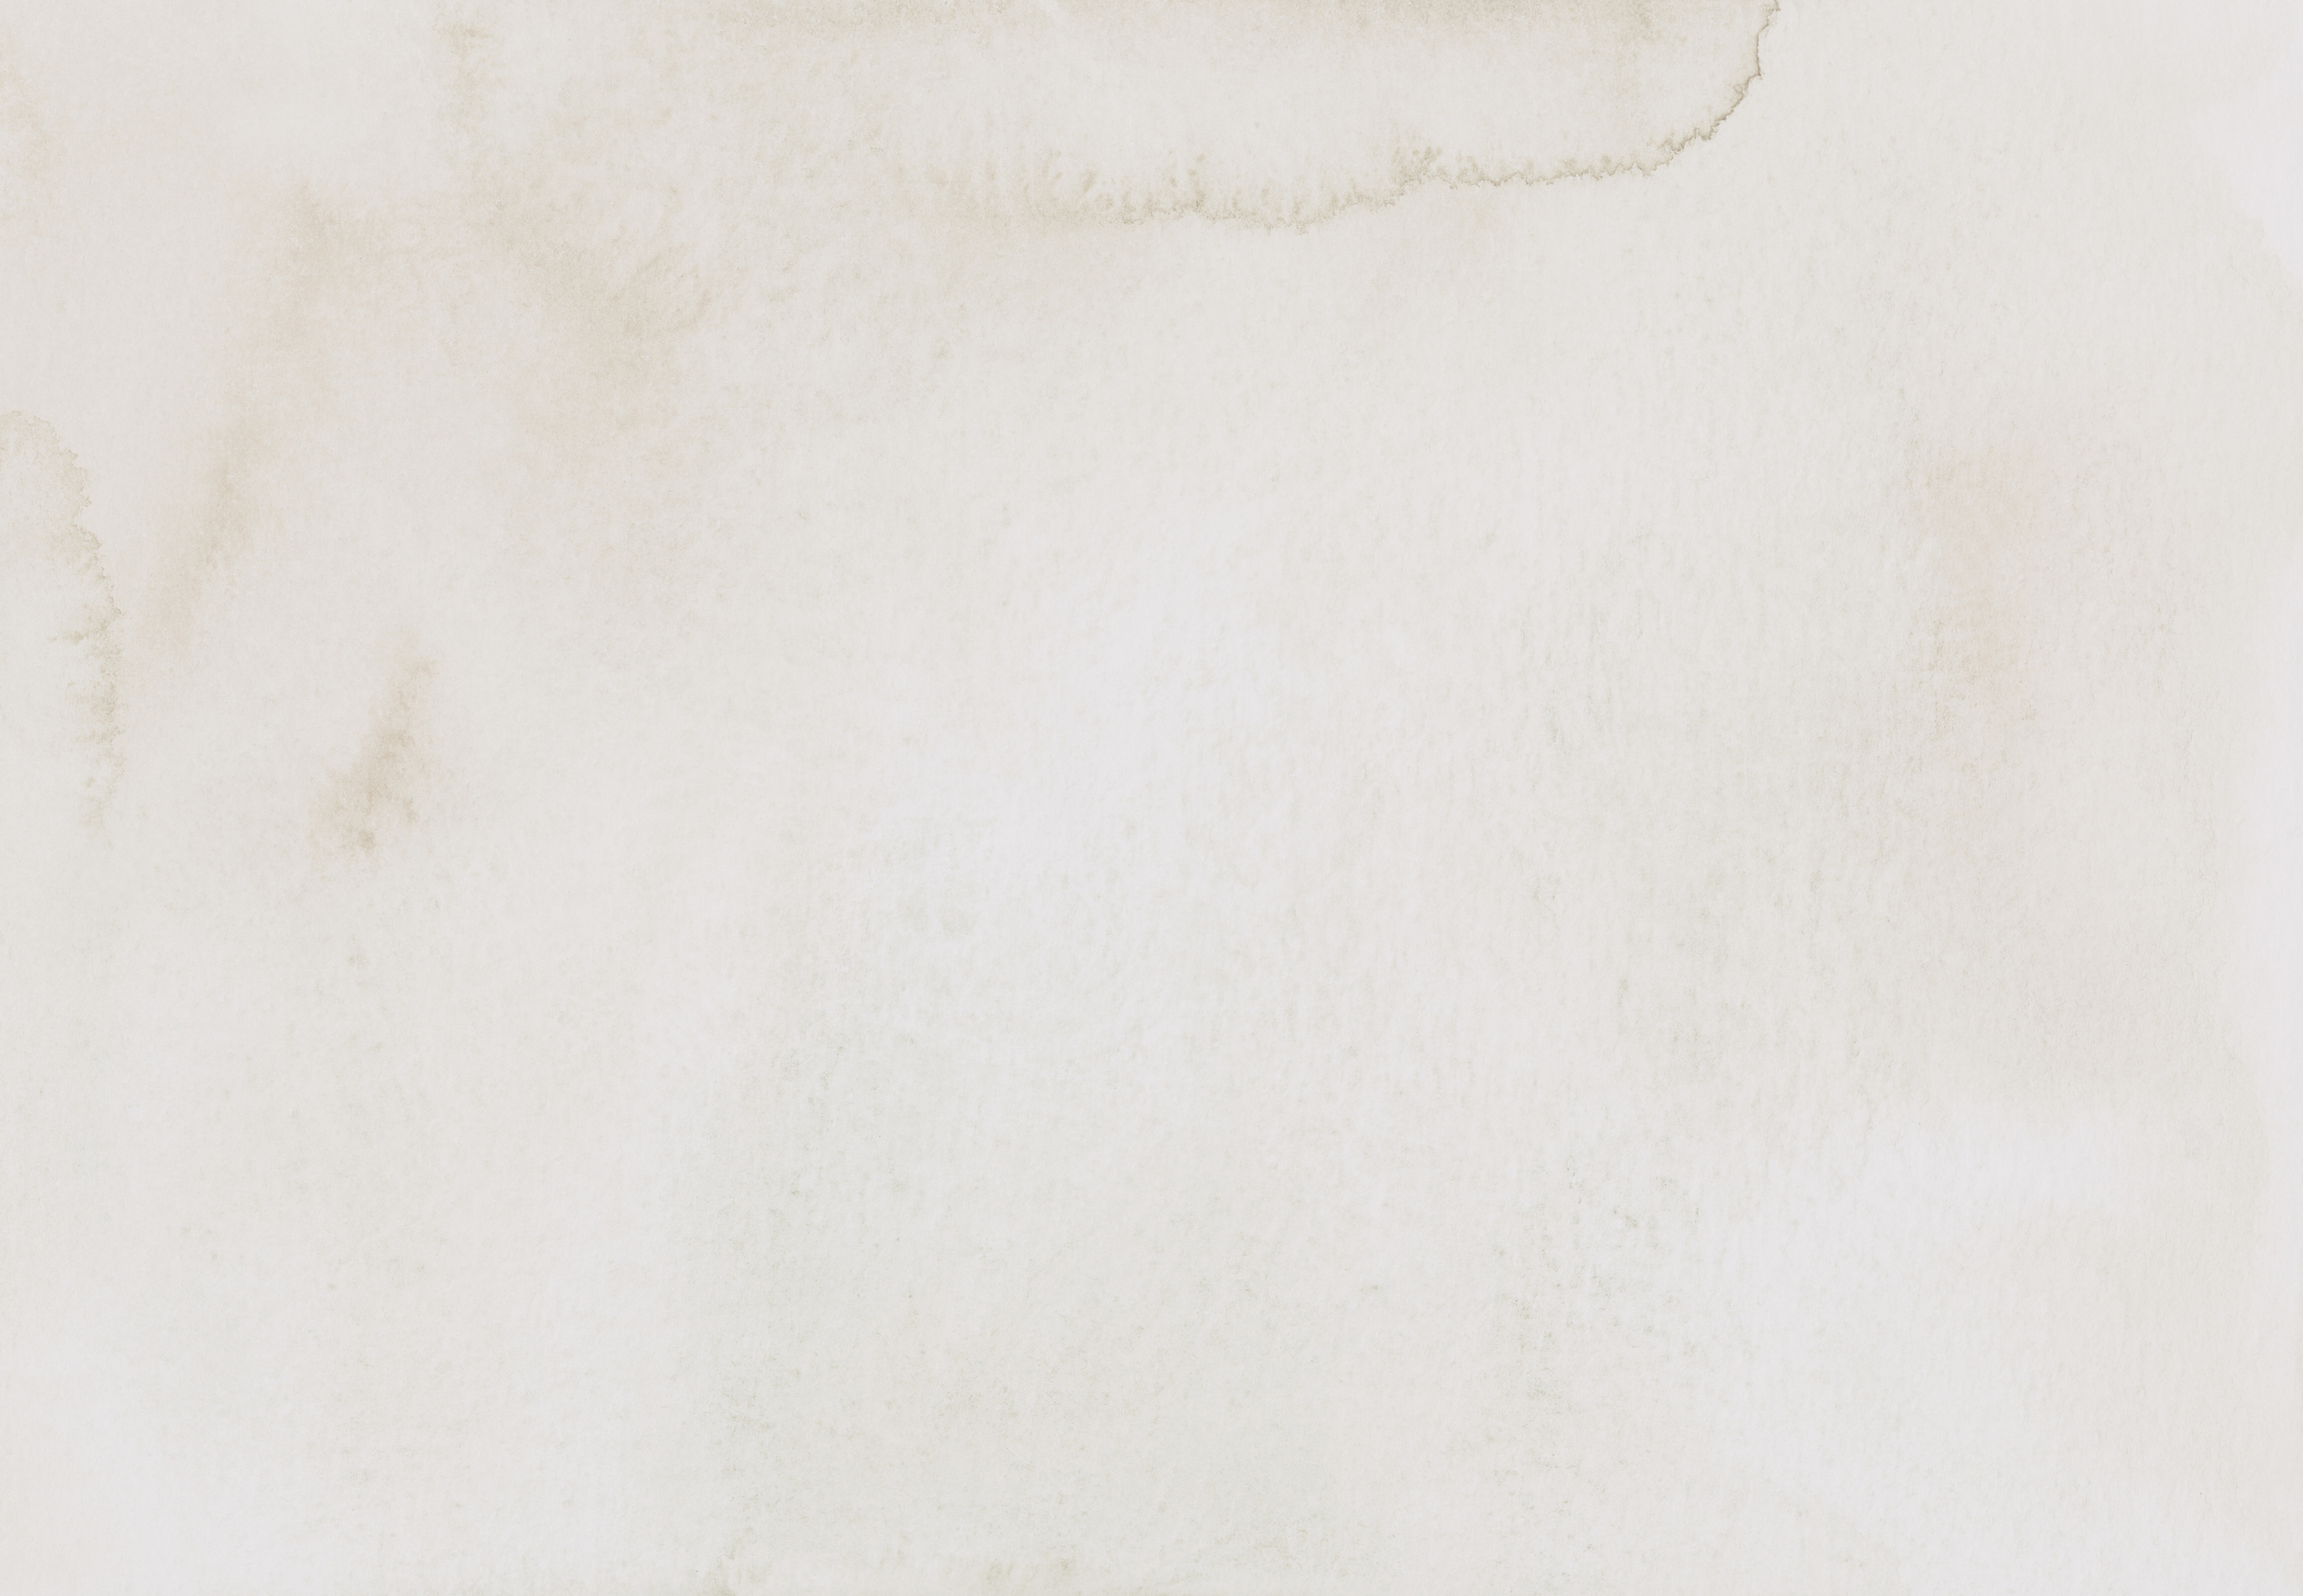
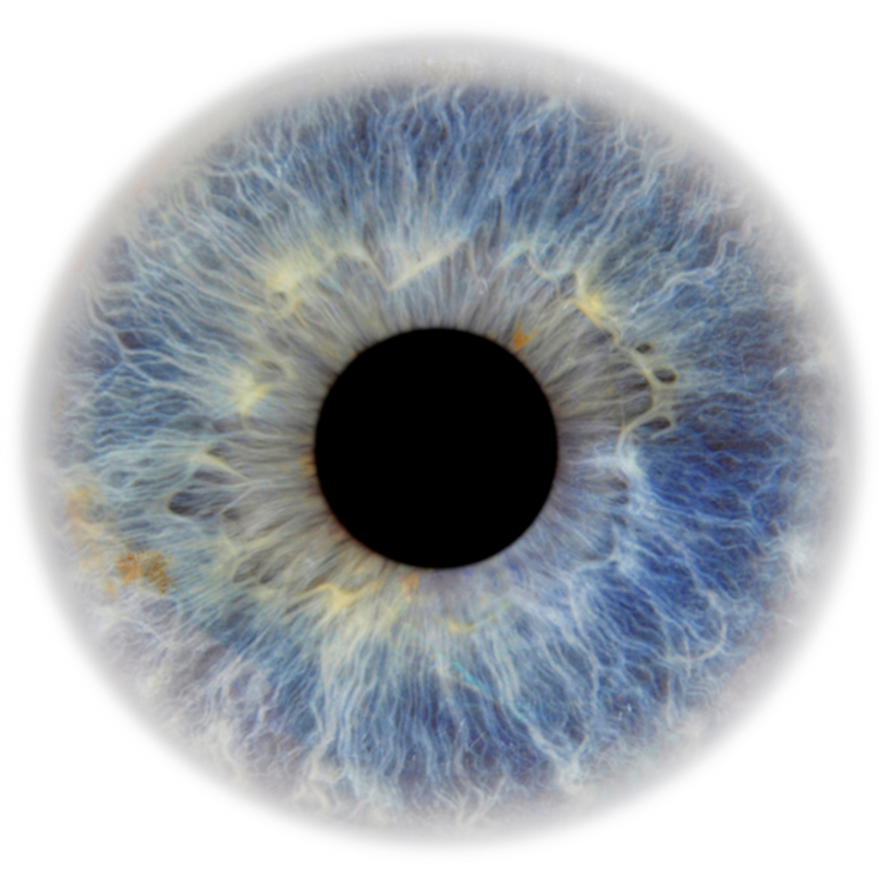

ReSeeAI
AI-BASED RETINAL DISEASE DETECTION FROM
FUNDUS IMAGES
SHABAAZ HUSSAIN, SHEHARYAR KHAN |
G202402800, G202404260
Supervisor: Muzammil Behzad |
muzzammil.behzad@kfupm.edu.sa

Slide 2
THE EYE:
A WINDOW TO OVERALL HEALTH
Why the eye is an important indicator for your health

Slide 3
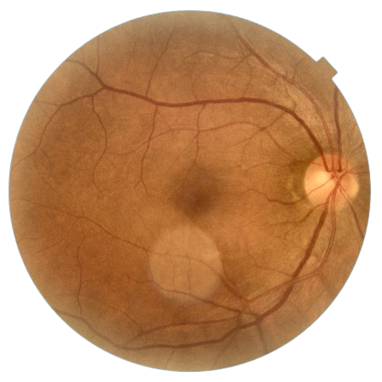
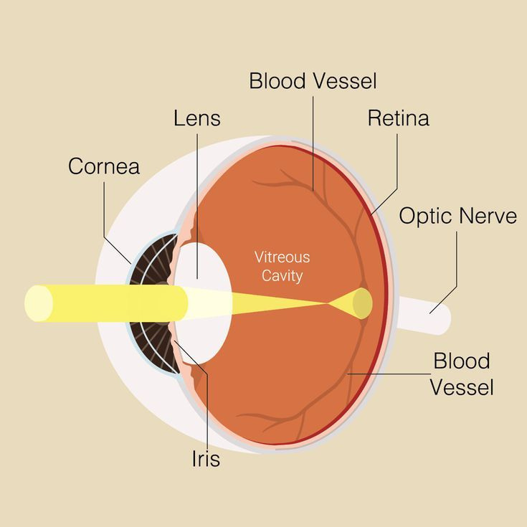
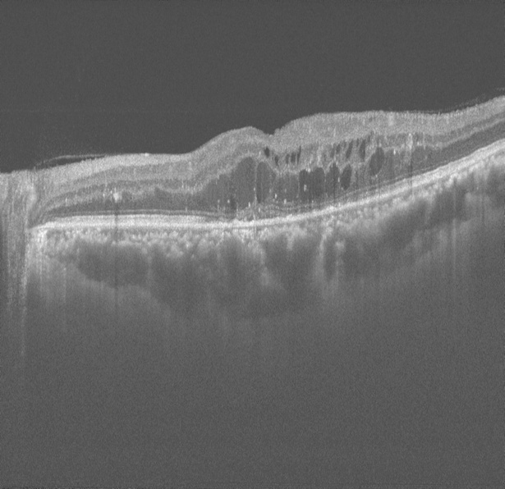
Picture of the retina
Layers of the retina

Slide 4
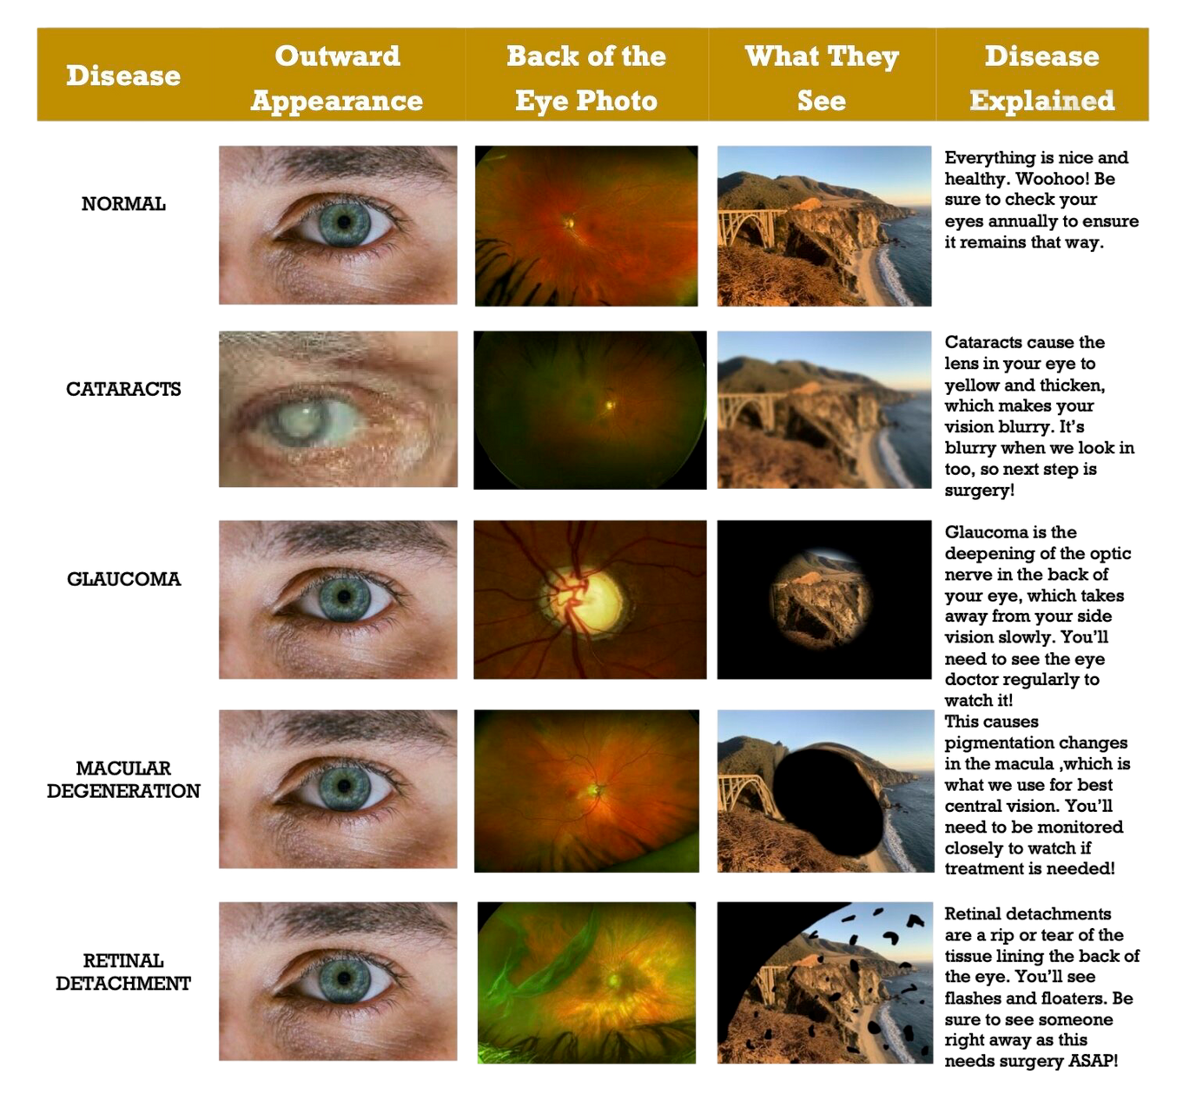

Slide 5
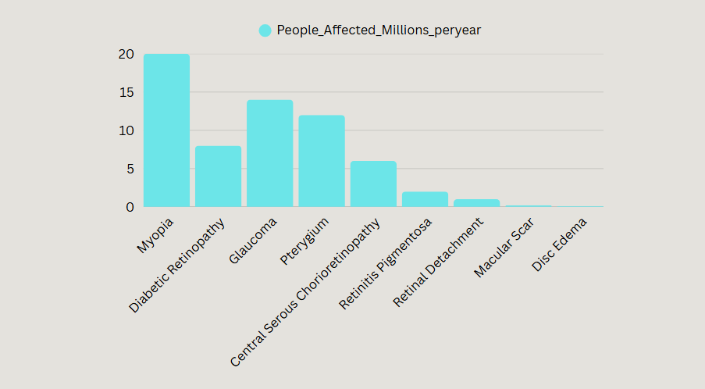

Slide 6
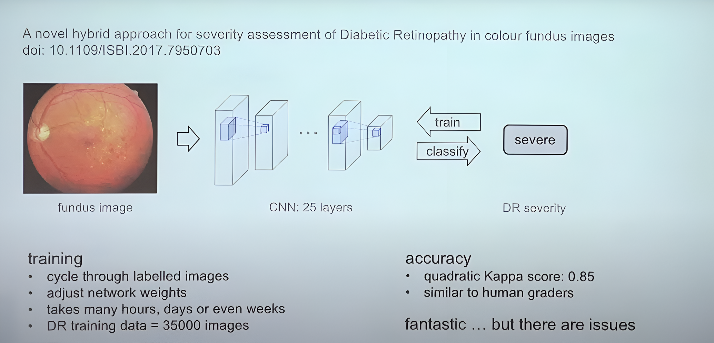
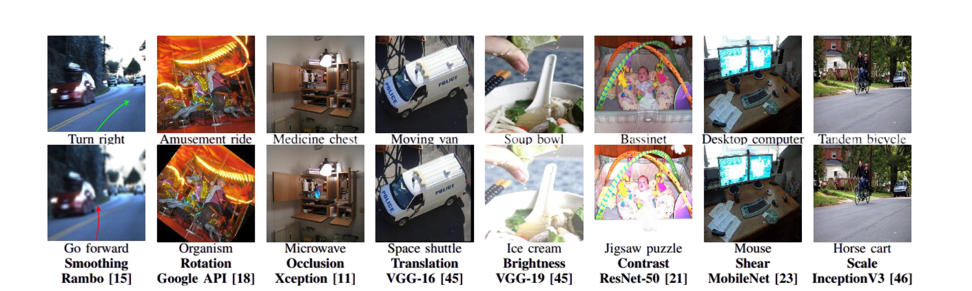
LIMITATIONS OF
CNNS

Slide 7
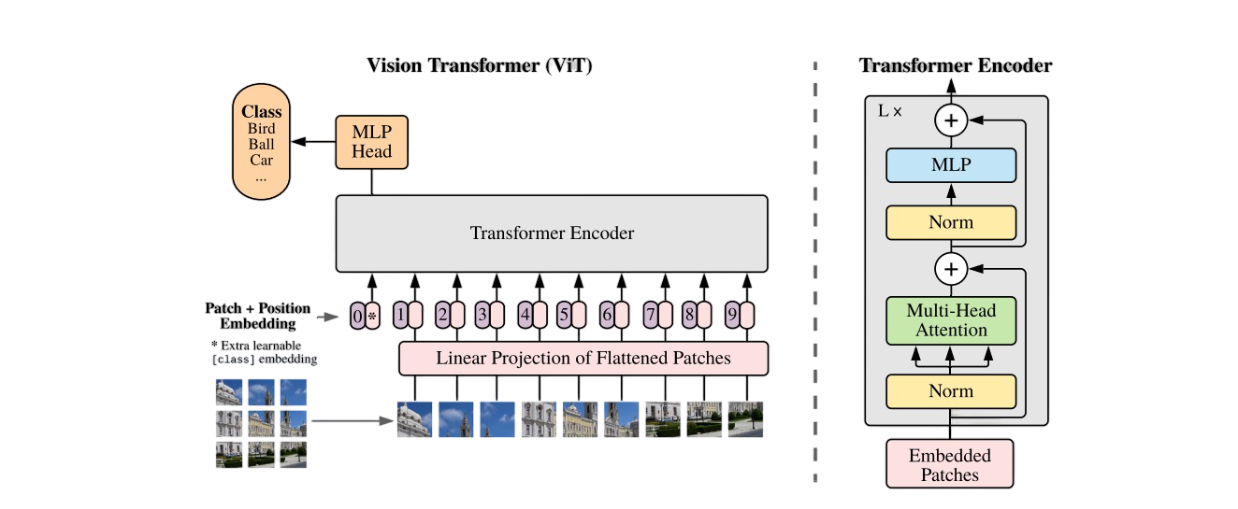

Slide 8
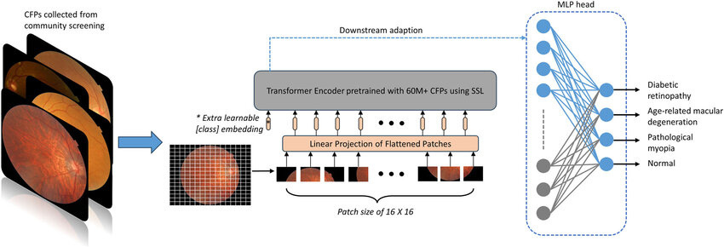

Slide 9
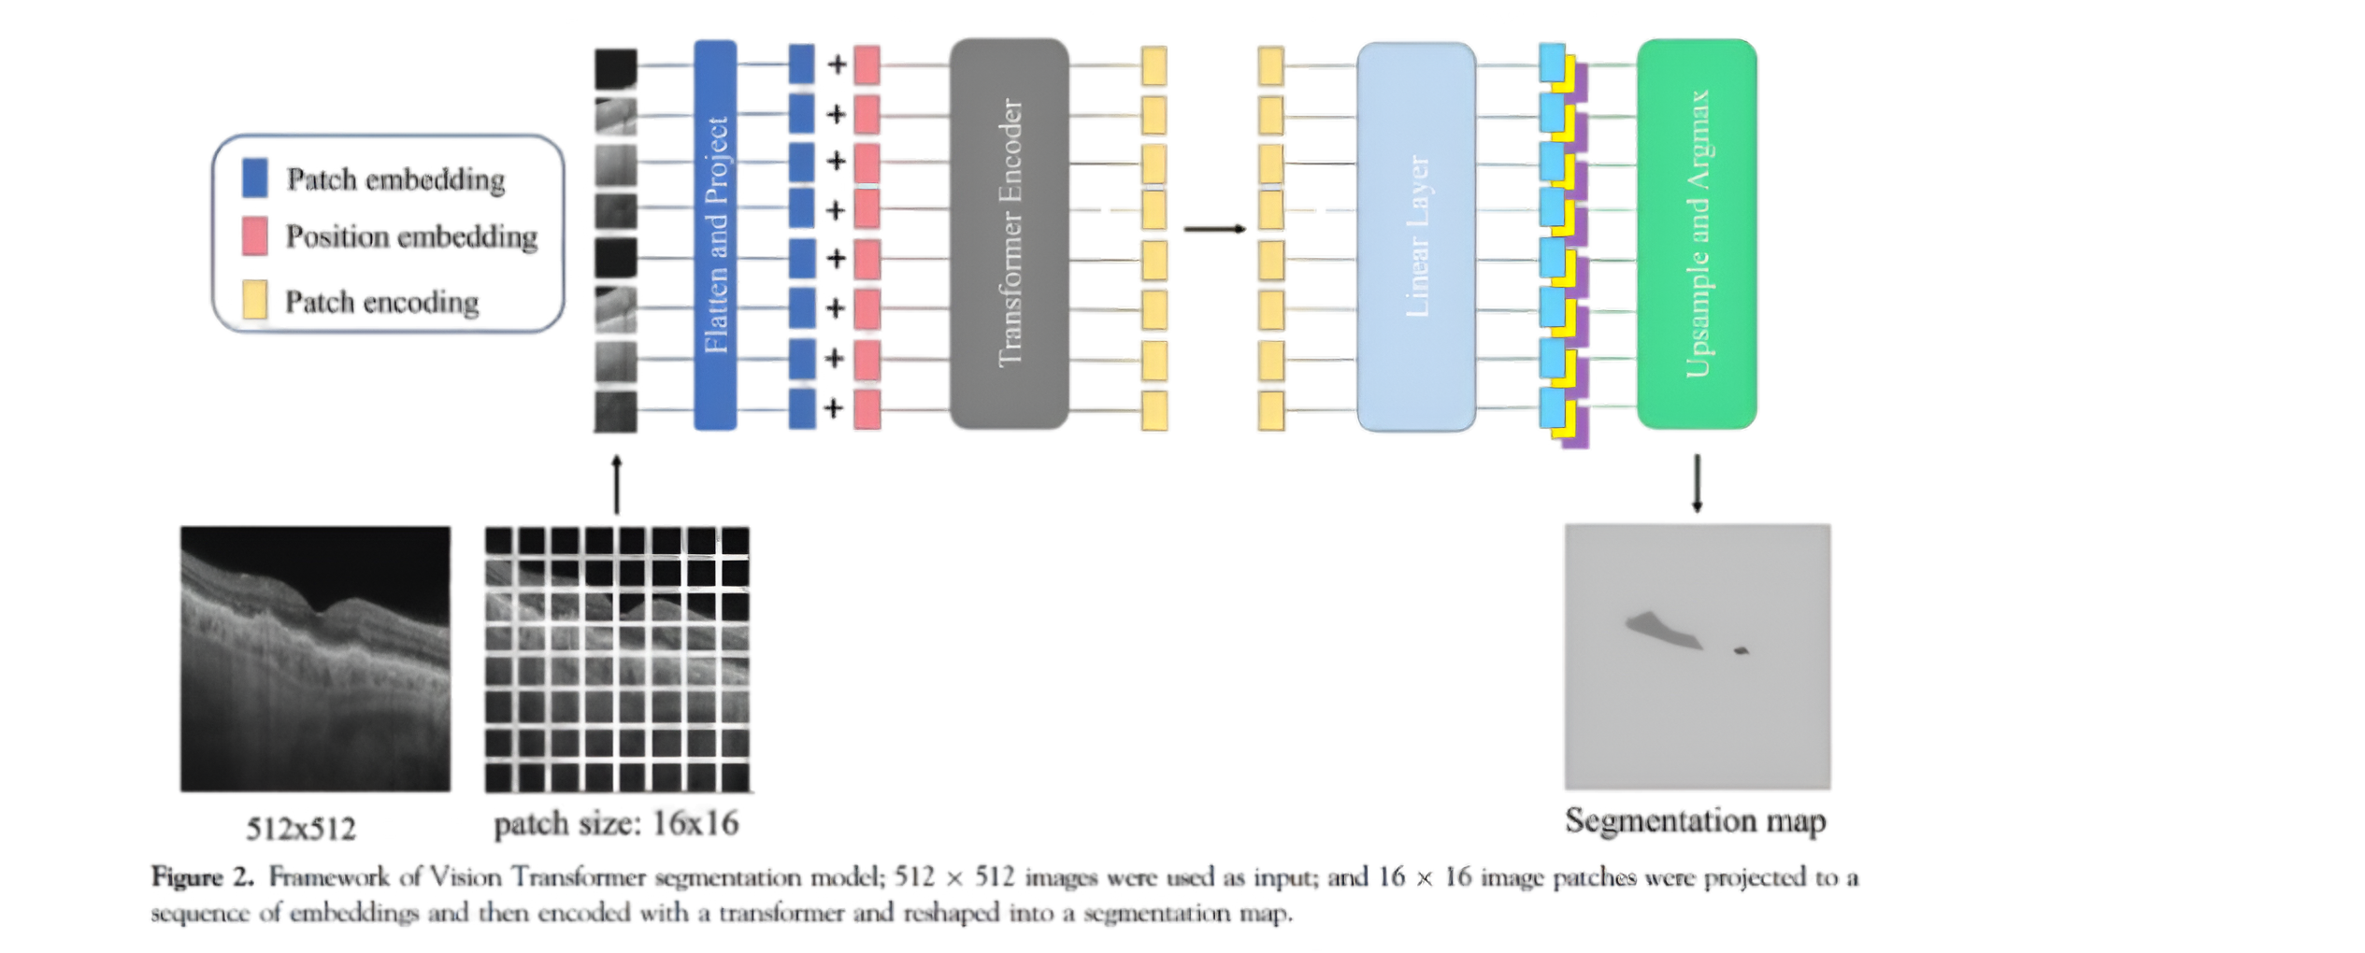

Slide 10
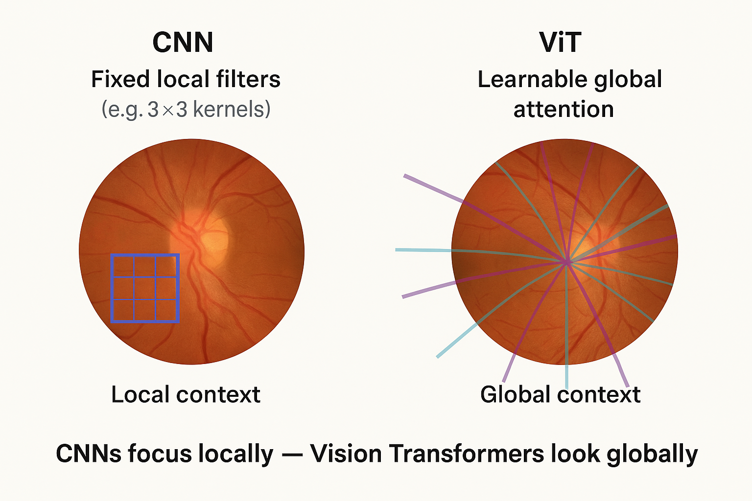

Slide 11
Modelling: RETFound_MAE: Revolutionizing Retinal Disease Detection
MAE: Masked Auto Encoders (Meta AI)
RETFound: A large-scale foundation model trained on 1.6 million unlabeled retinal images using self-supervised learning.
Purpose: Learns generalizable representations from retinal images, enabling efficient adaptation to various disease detection tasks.
Training Approach: Utilizes a masked autoencoder (MAE) framework, allowing the model to predict missing parts of an image, thereby learning meaningful features without explicit labels.
Adaptability: Can be fine-tuned with minimal labeled data for tasks like detecting diabetic retinopathy, age-related macular degeneration, glaucoma, and even systemic diseases like heart failure.

Slide 12
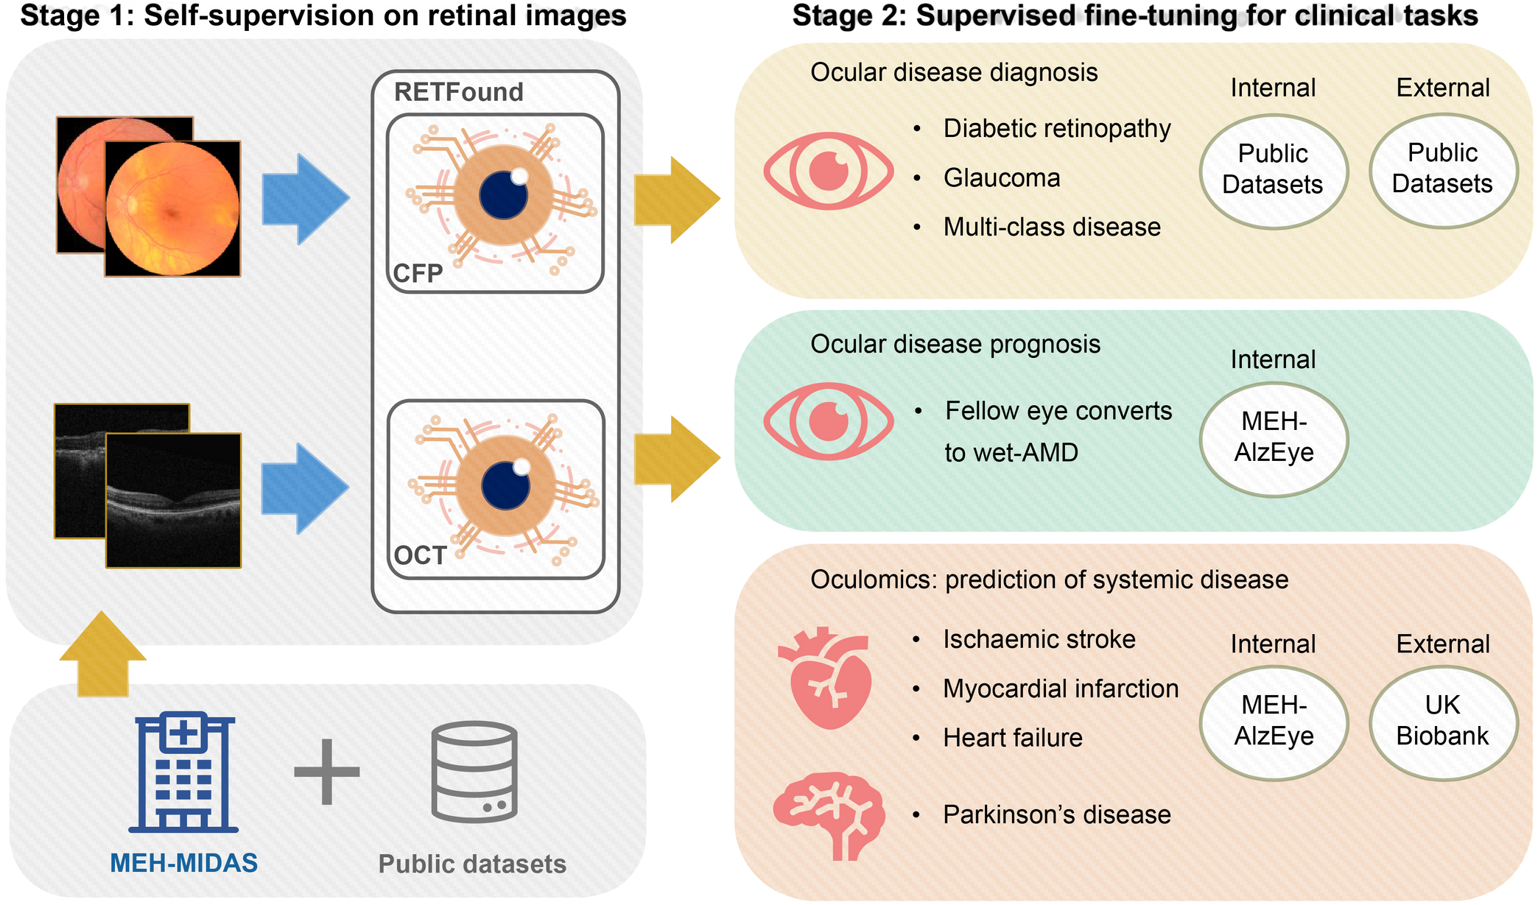

Slide 13
RETFound Adaptation
Transfer Learning Strategies
Linear Probe – Trained only the head (all other layers frozen)
Partial Fine-Tuning – Unfrozen last few transformer blocks + head
Full Fine-Tuning – Unfrozen all layers for complete adaptation (Best accuracy: 92%)
Adapters – Inserted lightweight trainable modules for efficient tuning

Slide 14
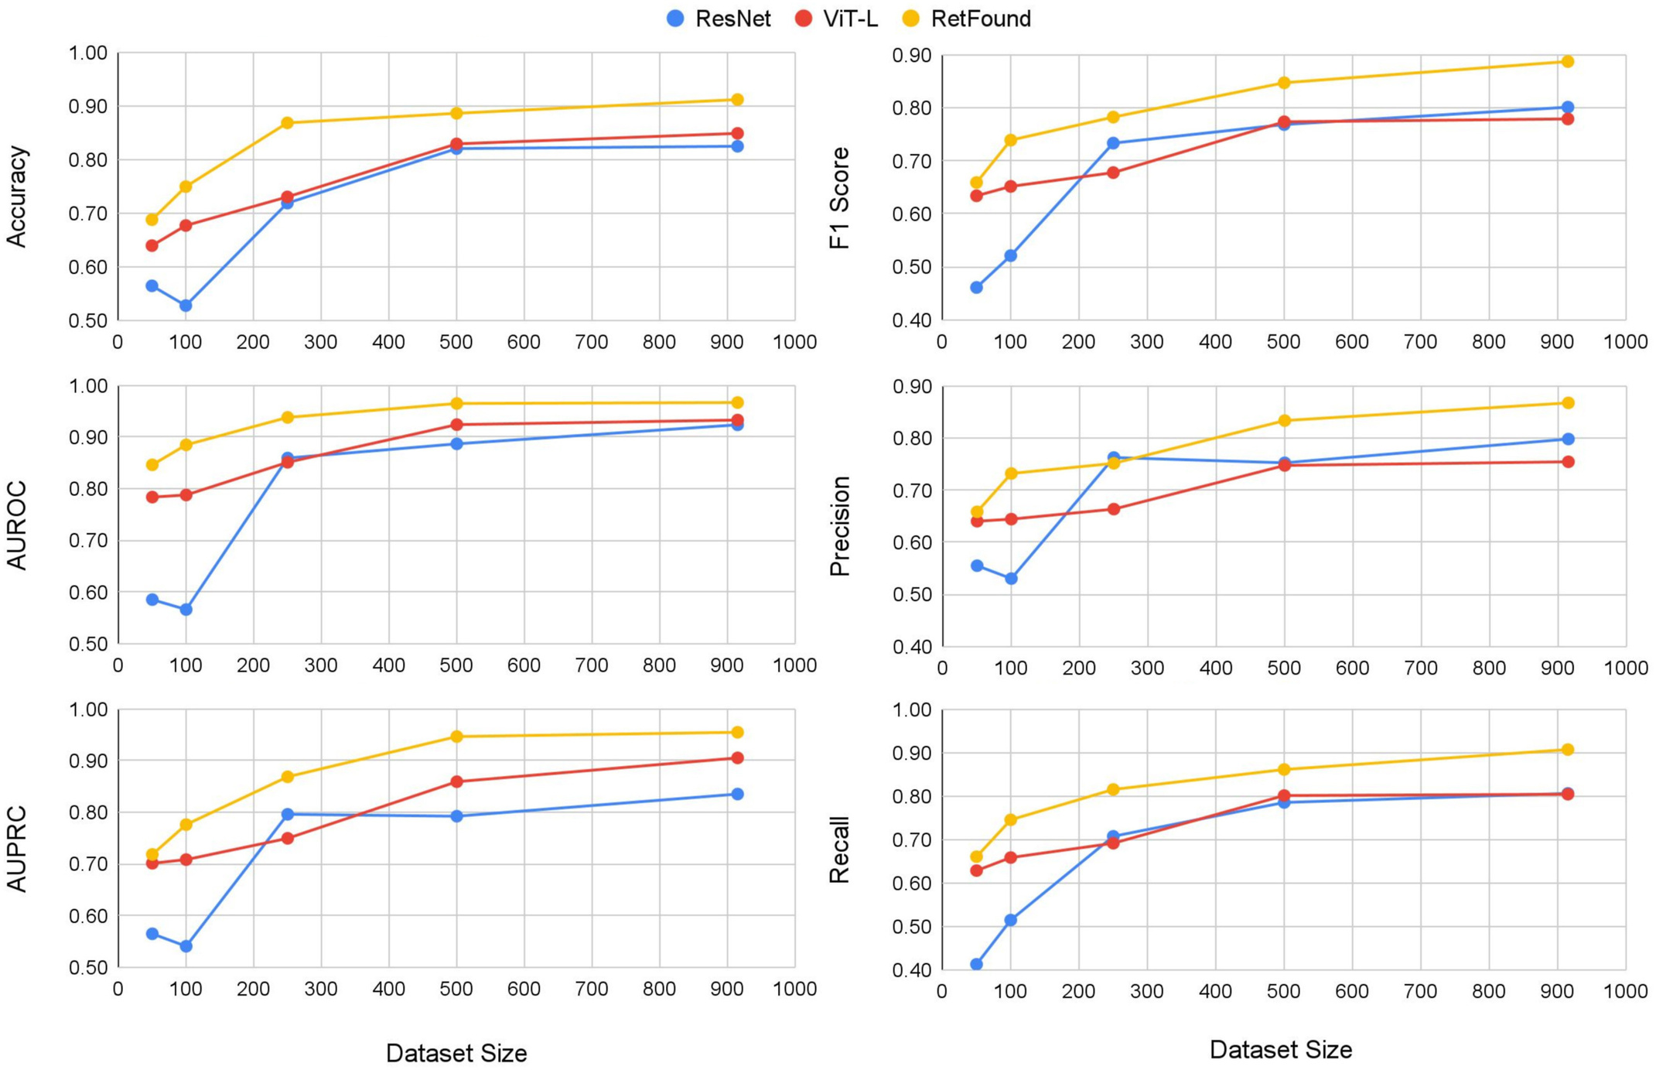
RETFound Evaluation on 1.6M Images

Slide 15
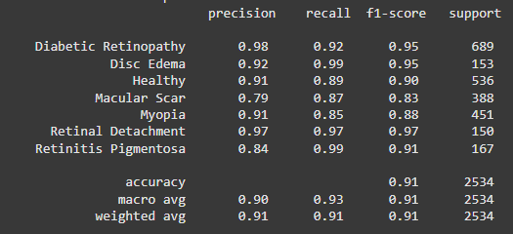
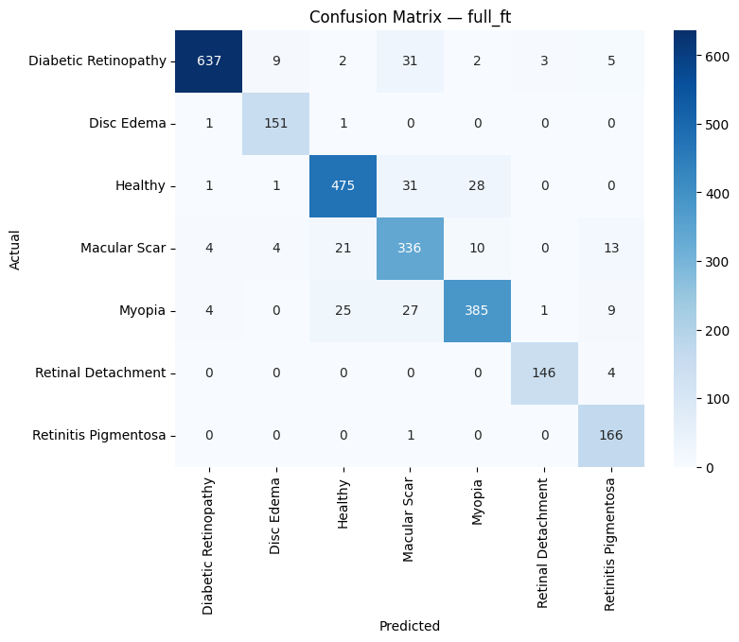
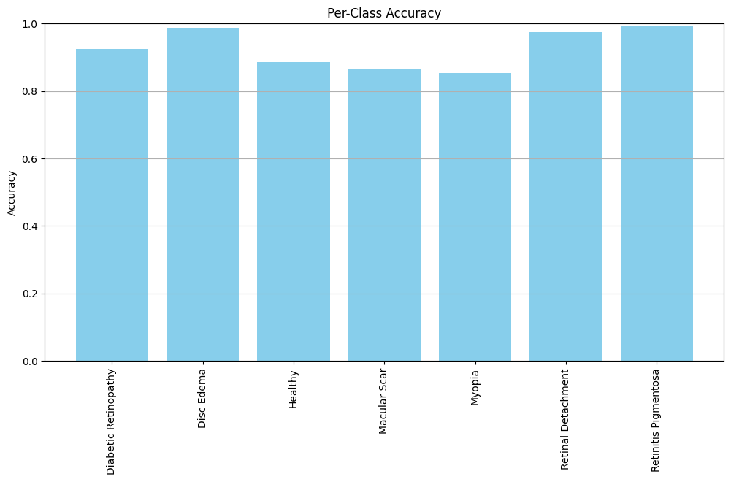
RETFound on 4K Images

Slide 16
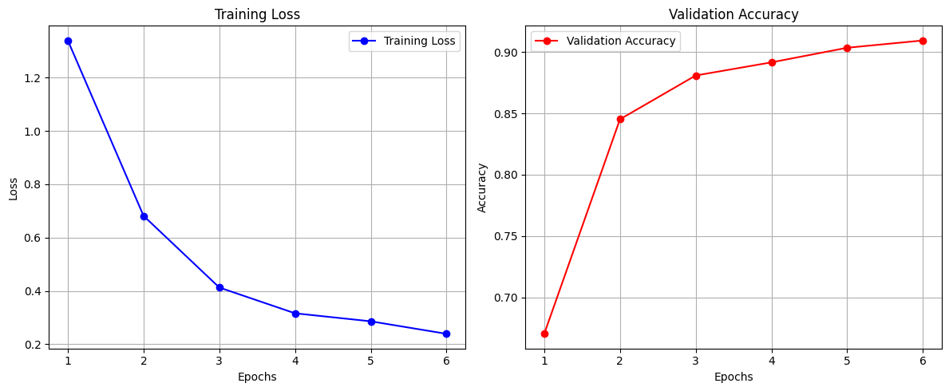
RETFound on 4K Images

Slide 17
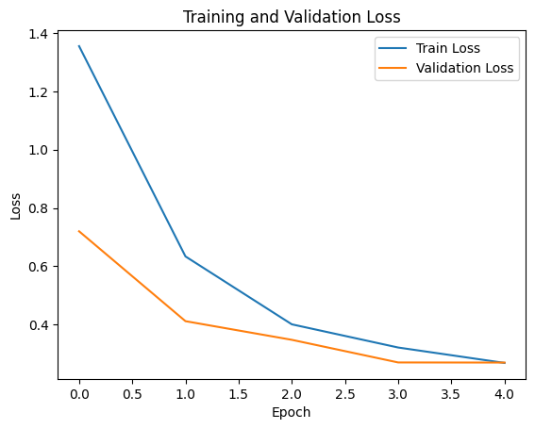
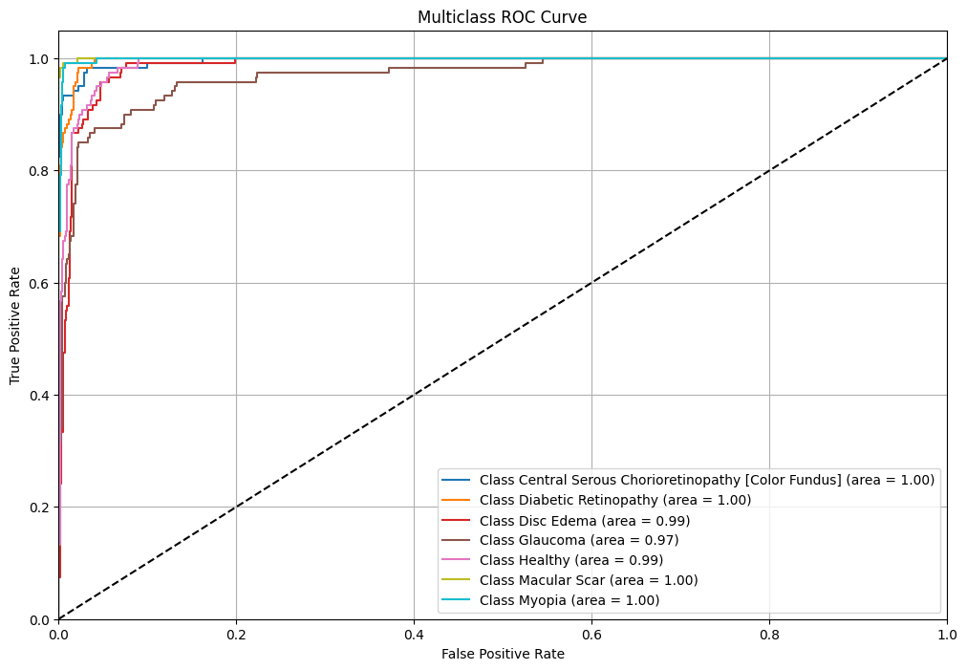
RETFound on 4K Images

Slide 18
Enhancements
Metrics | RETFound | ReSee
Accuracy | 92% | 92%
Epochs | 800 | 6
Data Size | 1.6M | ~4000
Training Time (A100 Nvidia) | 14 days | 30 minutes

Slide 19
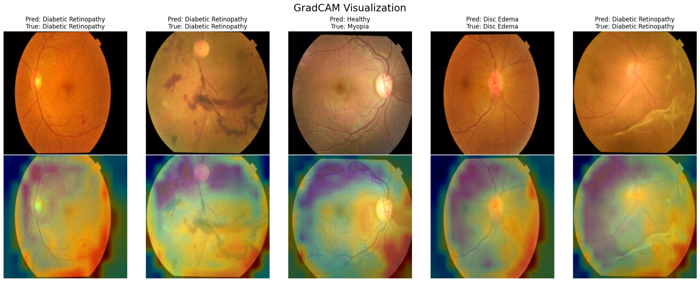
GradCam Visualization

Slide 20
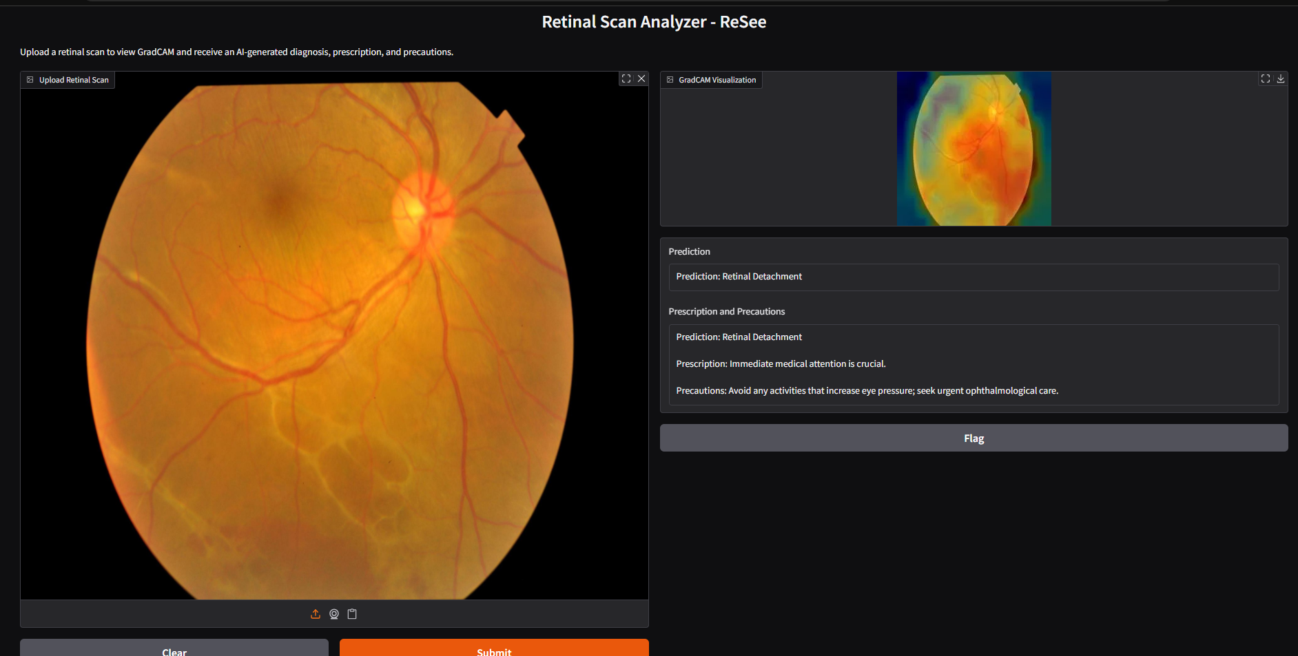
ReSee + Large Vision Models (LVMs)

Slide 21
THANK YOU

